Slide 1
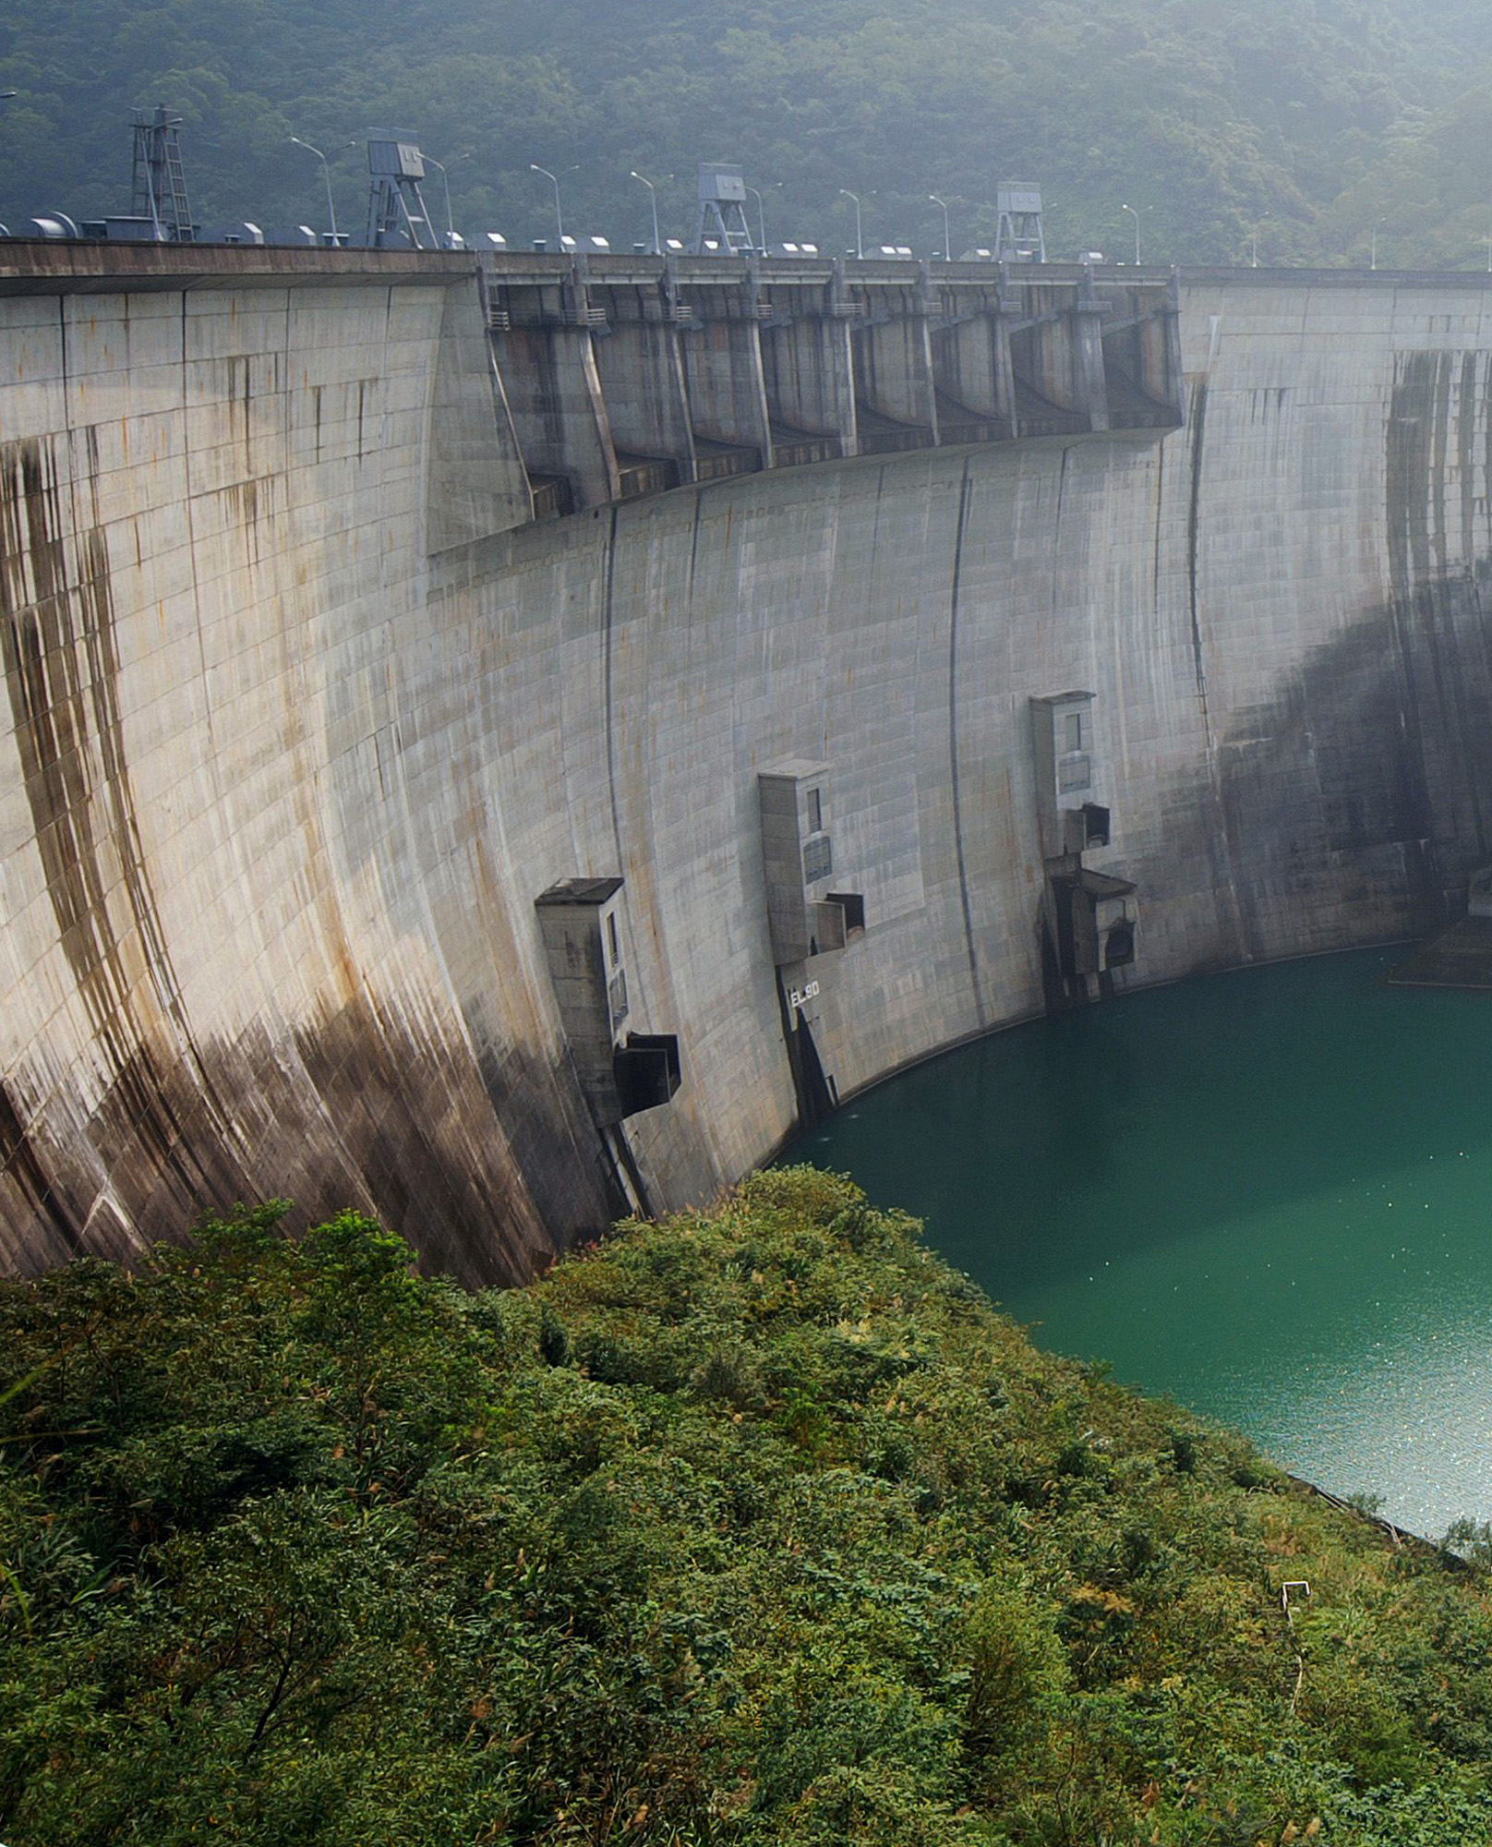
Project 5: Water Management
Seminar ‘Computational Economics‘
Felix Fink
Martin Wicke
Niklas Sayer

Slide 2
Agenda
Motivation
Theory, Implementation
Results
UPDATE!

Slide 3
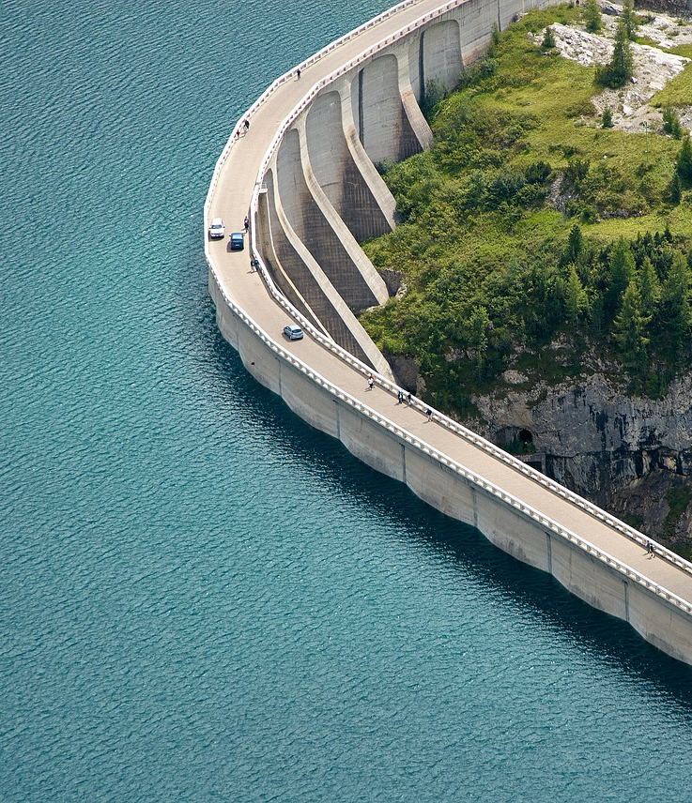
Motivation

Slide 4
Why would that be interesting?
Many regions in the world suffer from physical water scarcity
Population growth, lifestyle changes and climate change will worsen this problem
Higher demand and more volatile weather to be expected
Research suggests that just by managing existing sources of water more efficiently, the arising challenges could be met over the next 50 years

Slide 5
How do we tackle this problem?
One of the most important uses of surface water: Food production -> Irrigation of fields
We model a hypothetical water reservoir with 2 user groups: Farmers and Citizens
Water in the reservoir is replenished by statistically distributed rainfall

Slide 6
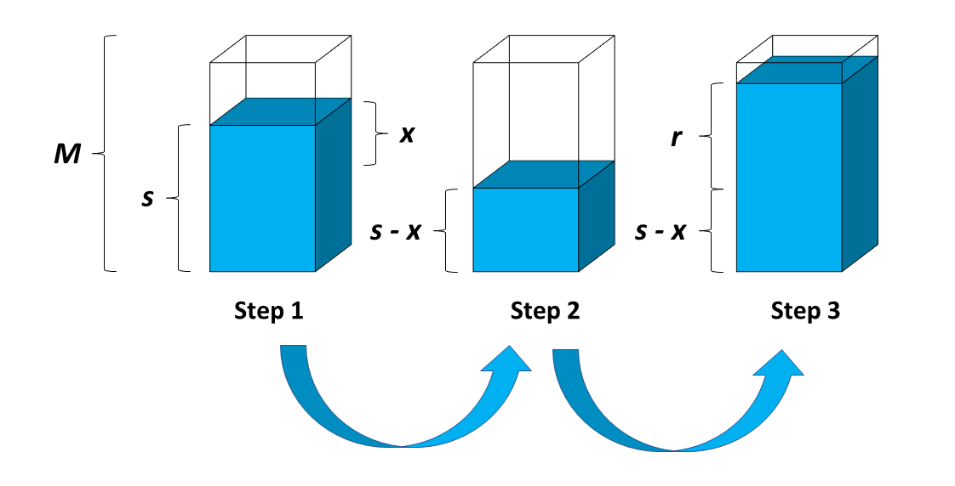
How exactly does that look like?
Goal: Find an optimal irrigation strategy that maximizes the combined utility
Infinite Horizon Dynamic Programming and Monte-Carlo simulation

Slide 7
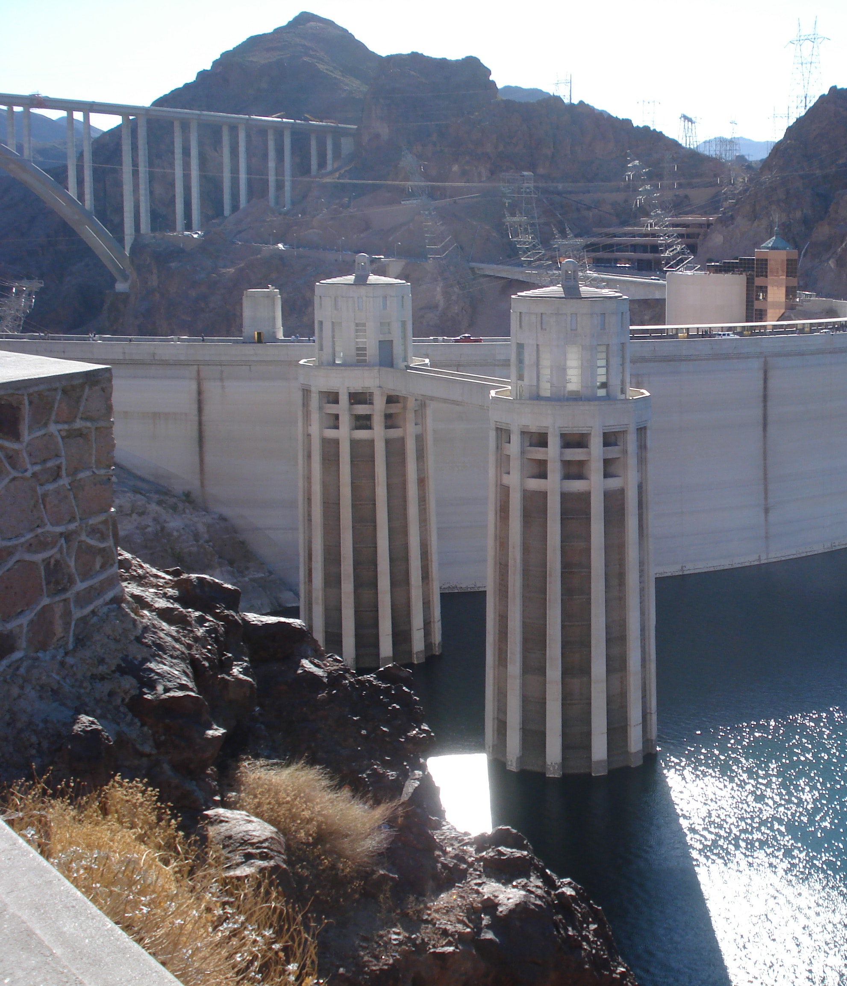
Theory

Slide 8
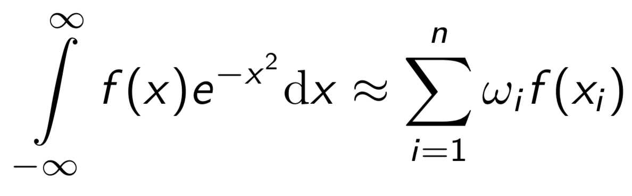
Gauss-Hermite for rain distribution
Rainfall follows lognormal-distribution
Parametrized with Gauss-Hermite we can calculate the expected value of the rain:

Slide 9
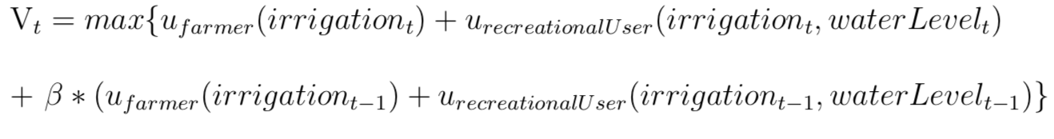
Value function
Maximize the utility of the farmers and of the recreational users
→ Find optimal irrigation policy to maximize utility for each water level

Slide 10
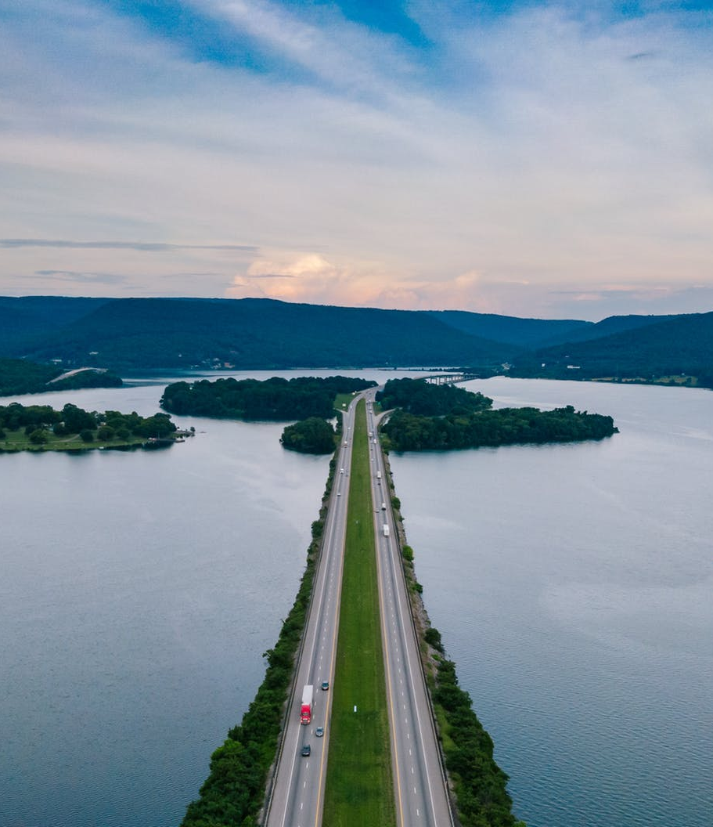
Results

Slide 11
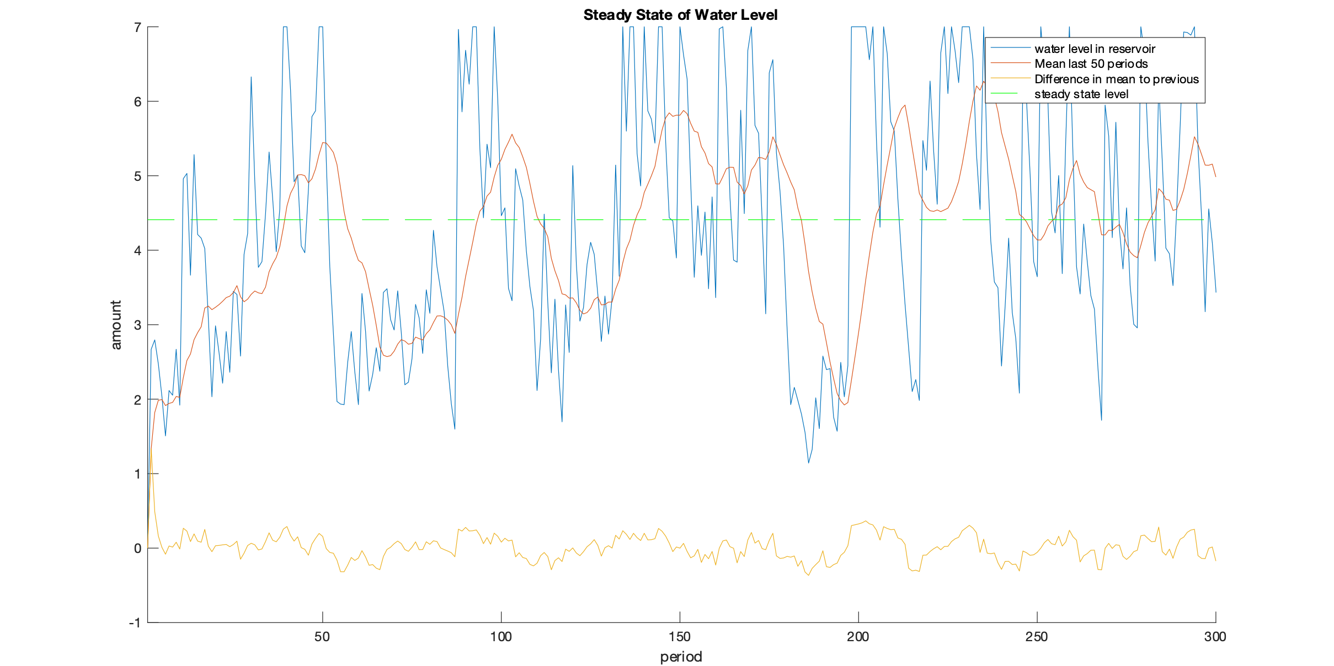
What is the steady state Level of the reservoir?

Slide 12
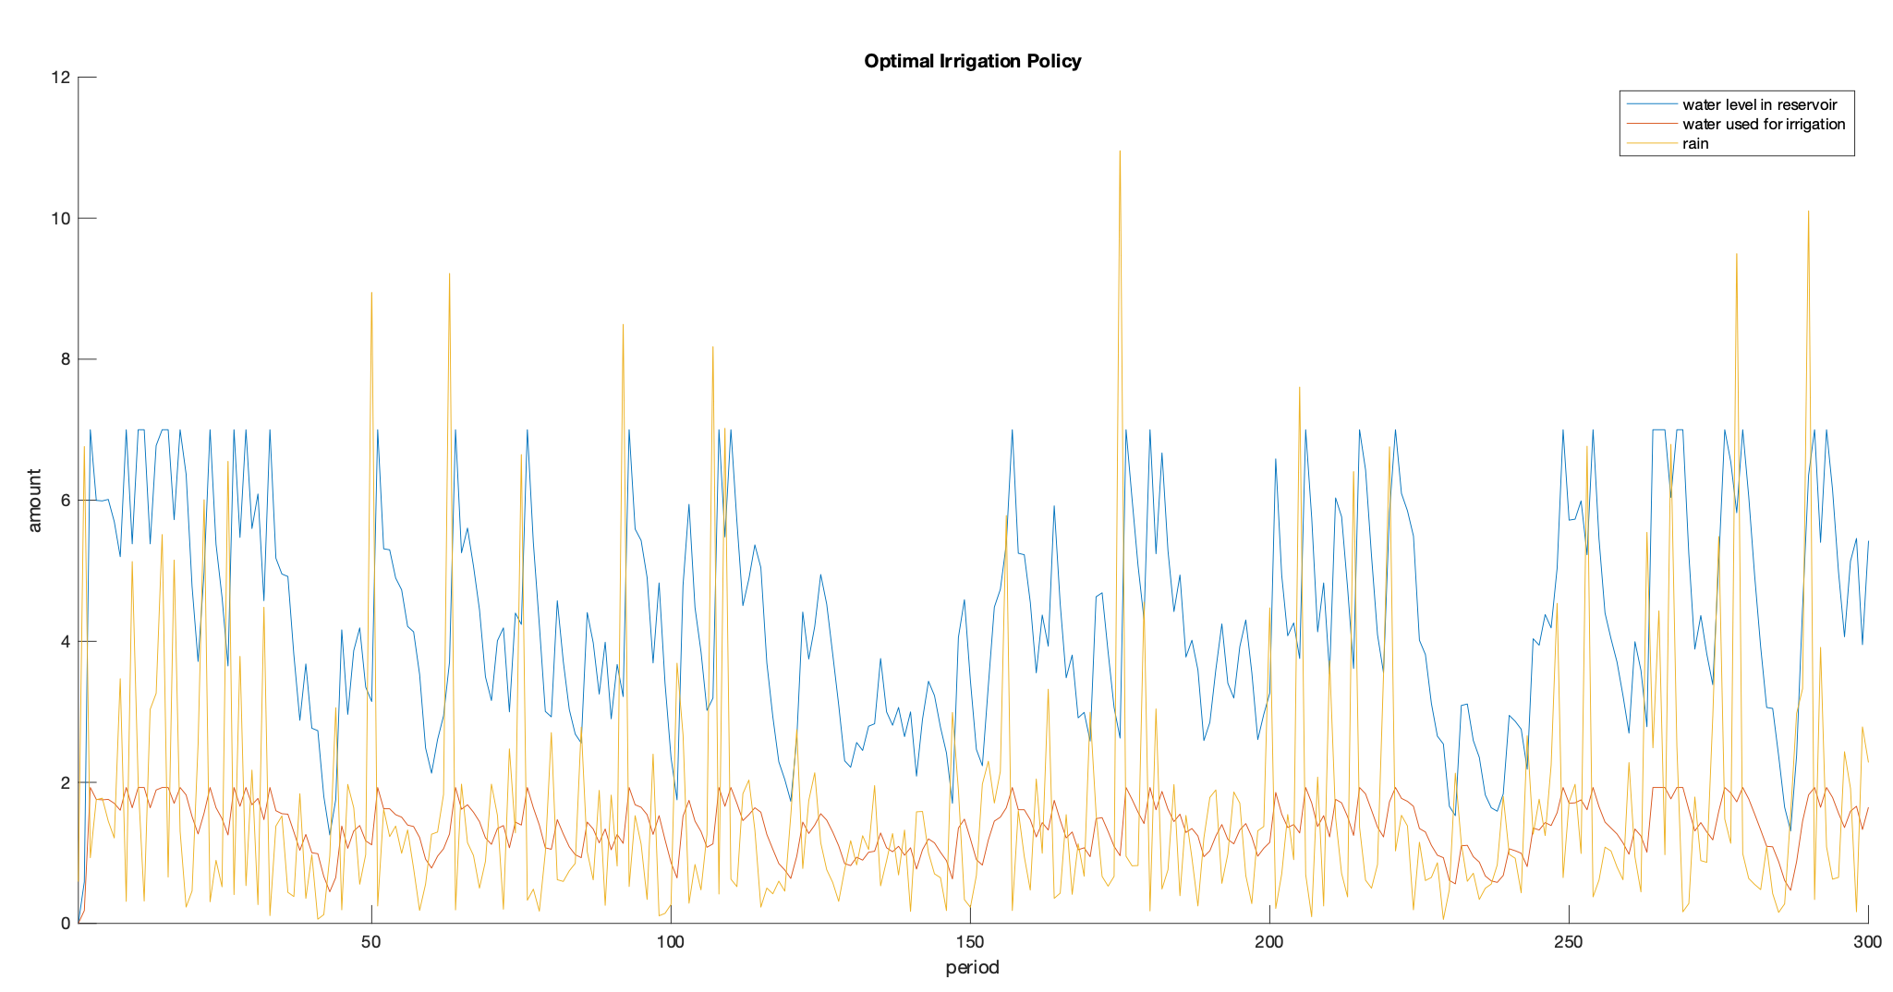
What irrigation policy maximizes the sum of utilities of farmers and recreational users?

Slide 13
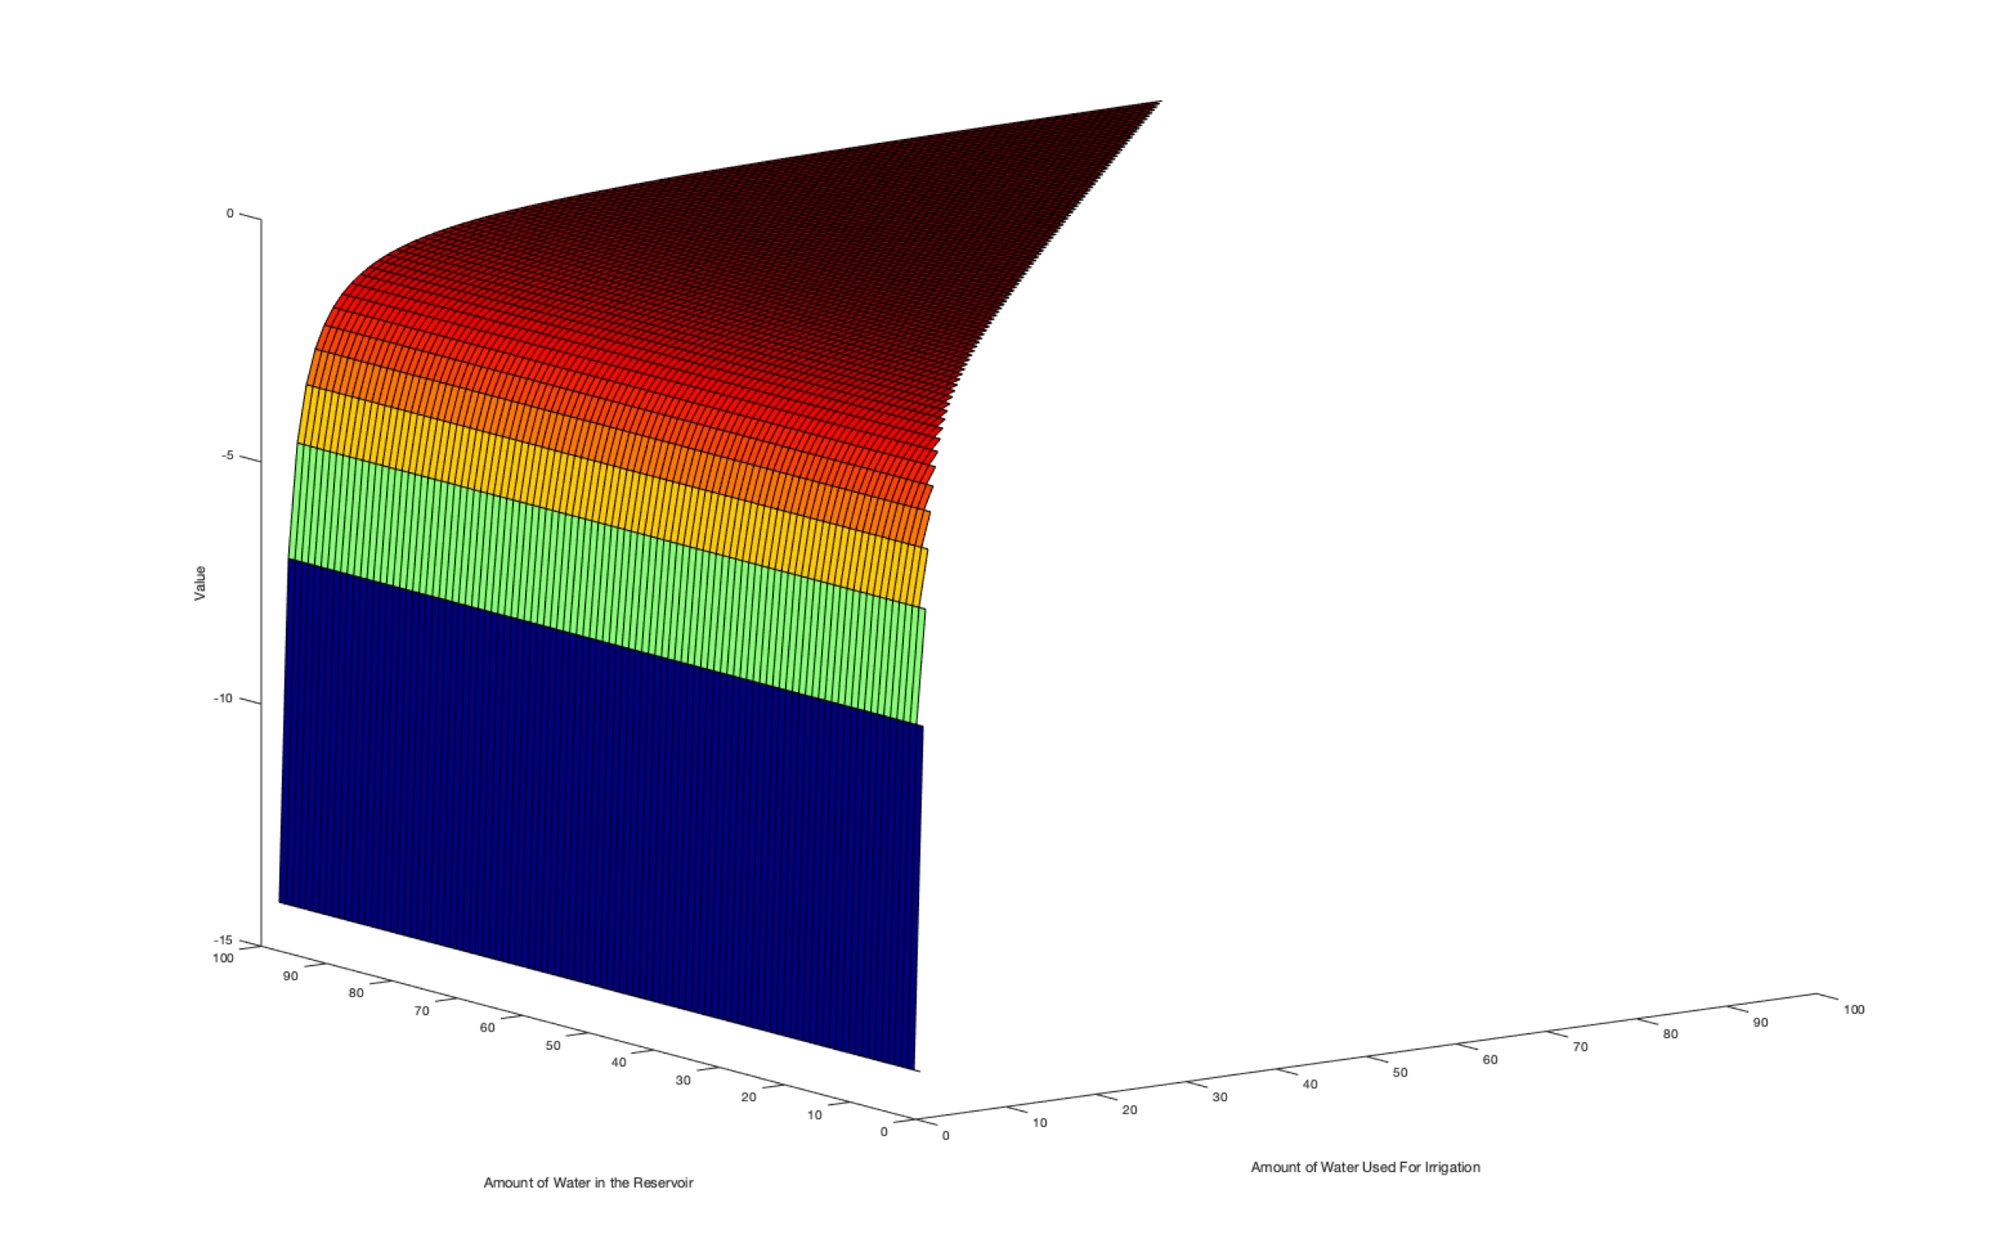
Value Function of Farmers

Slide 14
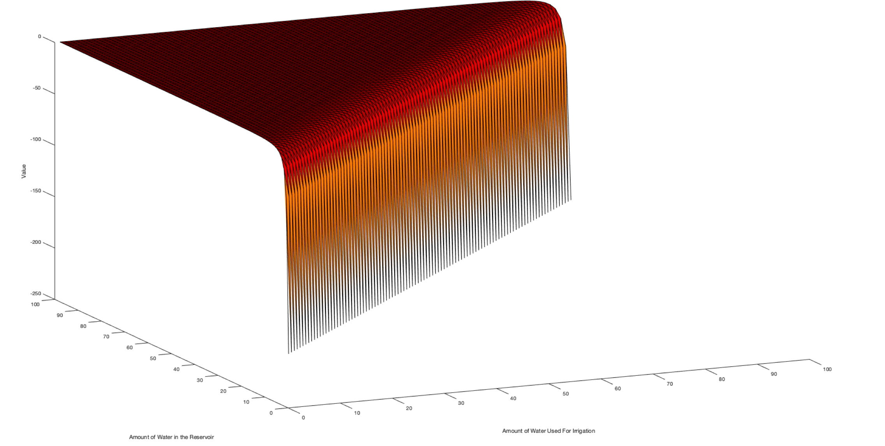
Value Function of Recreational Users

Slide 15
Thank you for your attention!

